Slide 1





AI, Cognition and Society
8. Systemic impacts of AI
Prof. Christopher Summerfield
University of Oxford
funding gratefully acknowledged

Slide 2

Questions
1. What impact is AI having on the jobs market? will AI “replace all cognitive labour” in the near future?
2. Discuss the global impact of AI on the economy, democracy, and geopolitical stability

Slide 3
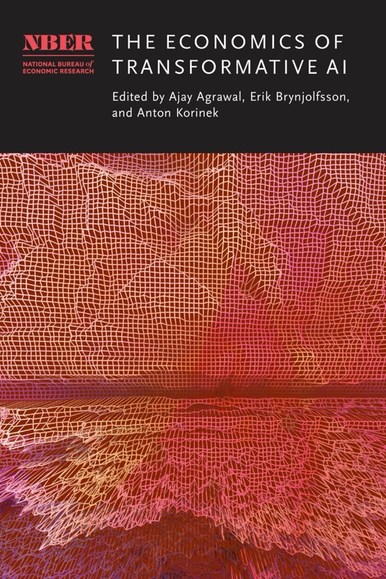
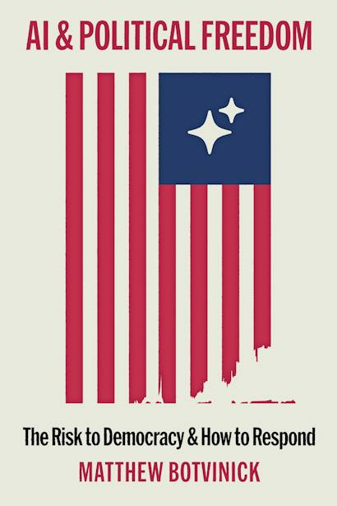
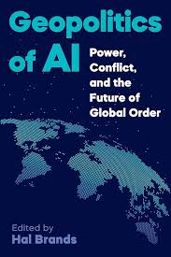
Reading

Slide 4
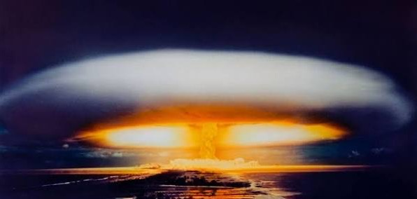
Systemic impacts
AI is a transformative technology
But some people think of AI as a totalizing technology – one that sweeps away everything in its wake
However, the impact of AI will depent on how it reshapes existing human systems and infrastructure.
Notes:
And of course each camp is exactly half right
AI is a transformative technology
and its impact will be felt through the systems and structures we’ve already built
and those include…
but of course the question is: this thing is happening….how do we make it go well? How do we build AI that is safe and beneficial?

Slide 5


Systemic impacts
democracy and freedom
the information ecosystem
economic prosperity and equality
labour market dynamics
geopolitical offense / defense
crime and social stability
relationships and mental health
education, skills and learning
The wold is a complex system. AI changes its dynamics.
Notes:
And of course each camp is exactly half right
AI is a transformative technology
and its impact will be felt through the systems and structures we’ve already built
and those include…
but of course the question is: this thing is happening….how do we make it go well? How do we build AI that is safe and beneficial?

Slide 6





Structure
AI and labour markets
AI and democracy / geopolitics
AI and sustainability
AI and the social fabric

Slide 7
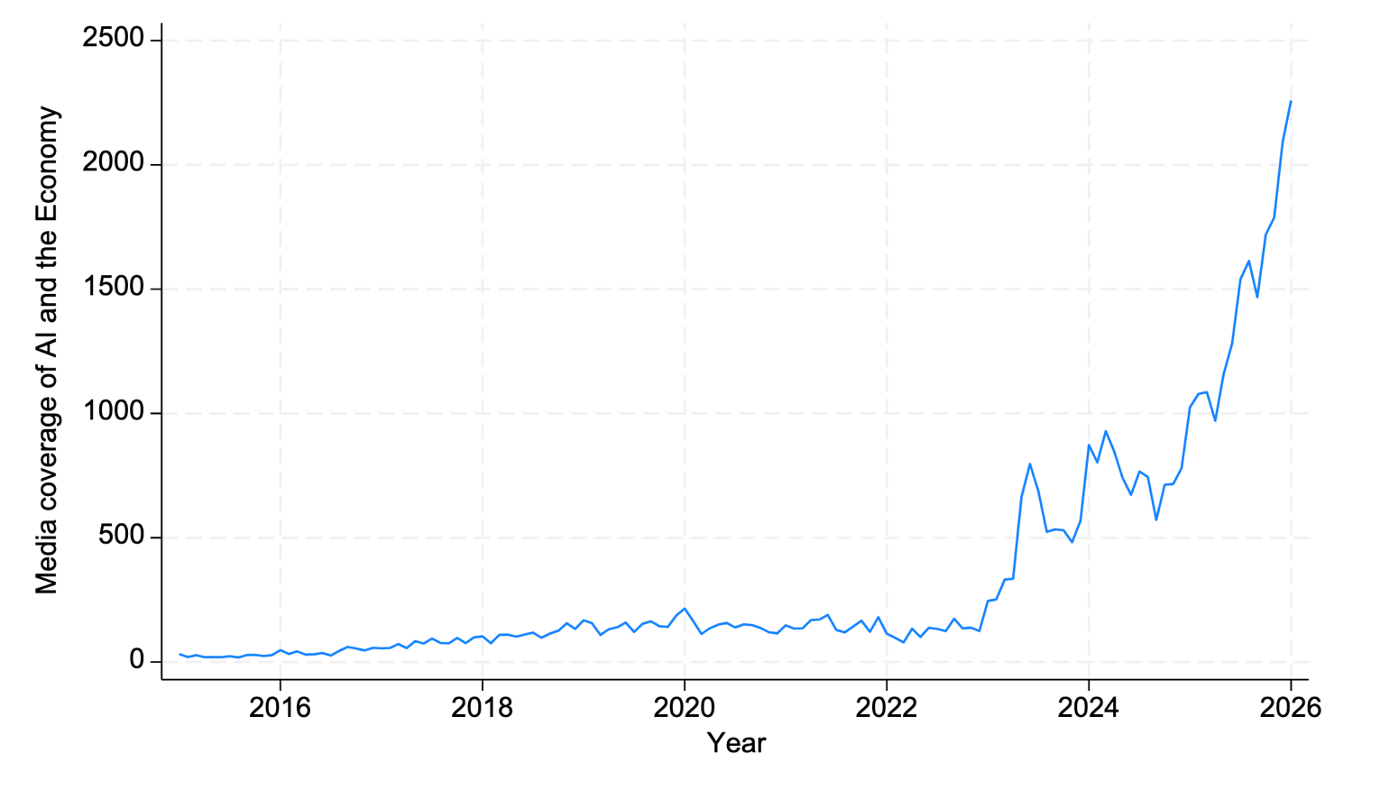
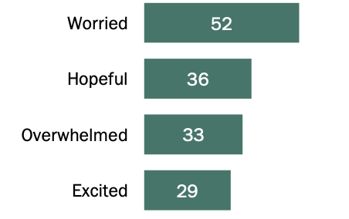
AI economics
52% of Americans are worried that AI will take their jobs
Yotov 2026; Pew Research 2025

Slide 8
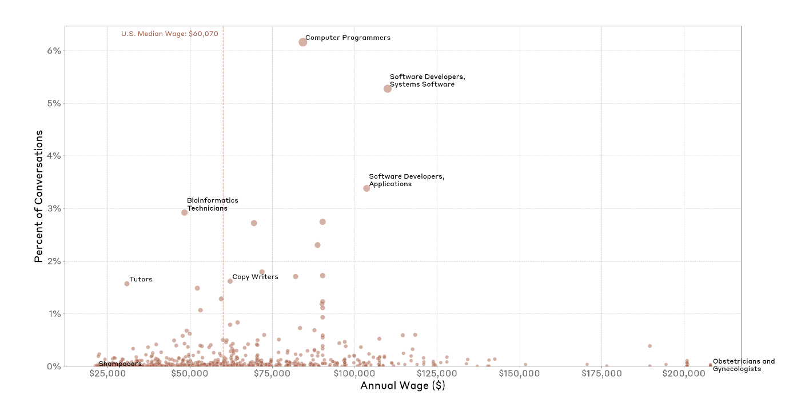
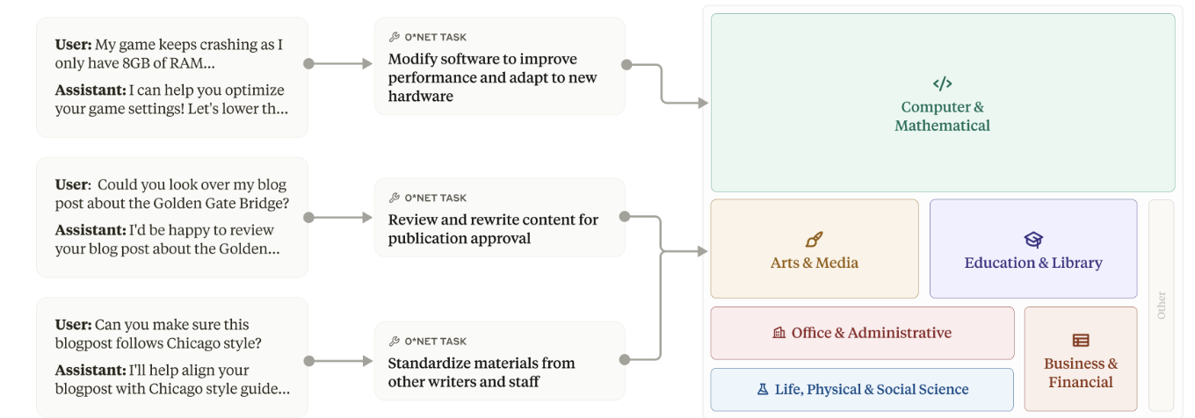
What is AI used for?
Use of AI is concentrated in a few professions focused on knowledge work (coding, knowledge digest, customer service)
Anthropic Economic Index
Handa 2026

Slide 9
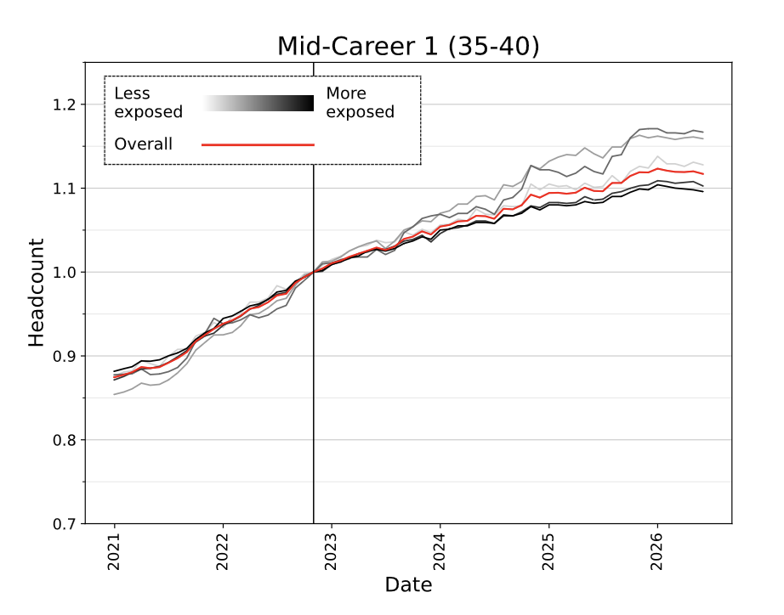
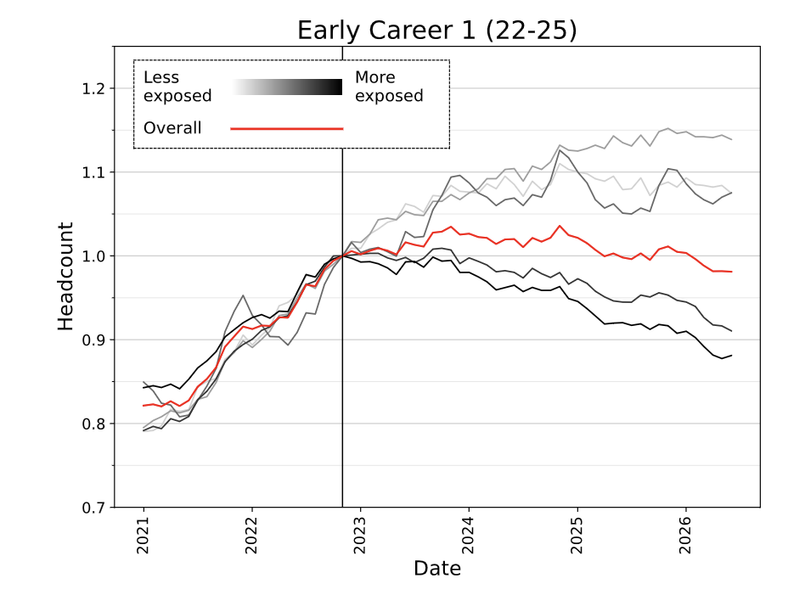
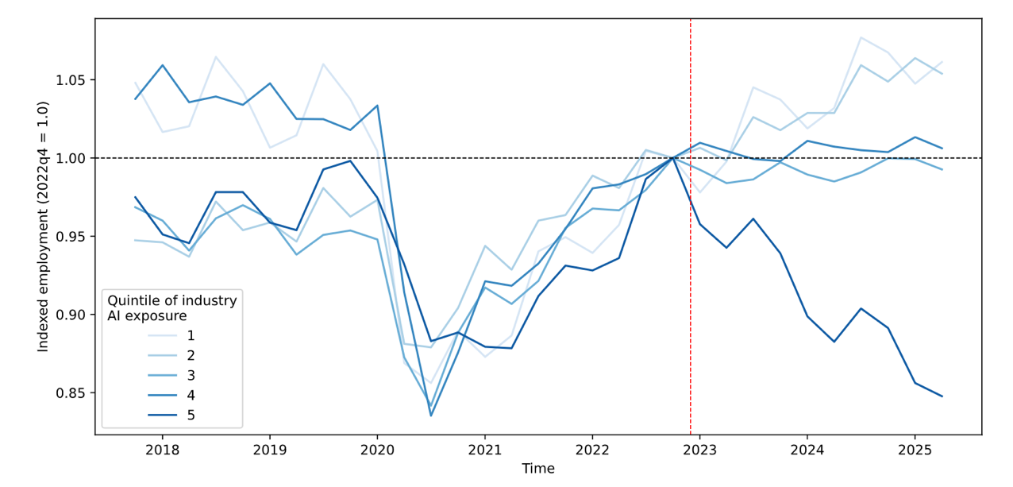
Labour markets
Similar effects independently reported in a US Census data for government employees
From payroll data: early career roles exposed to AI are declining (~20%). Are these “canaries in the coalmine” for other jobs?
Brynjolfsson 2026; Tucker 2026

Slide 10
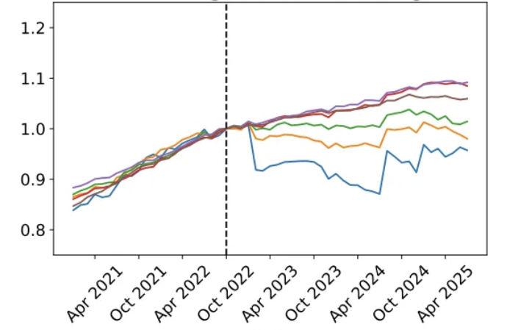
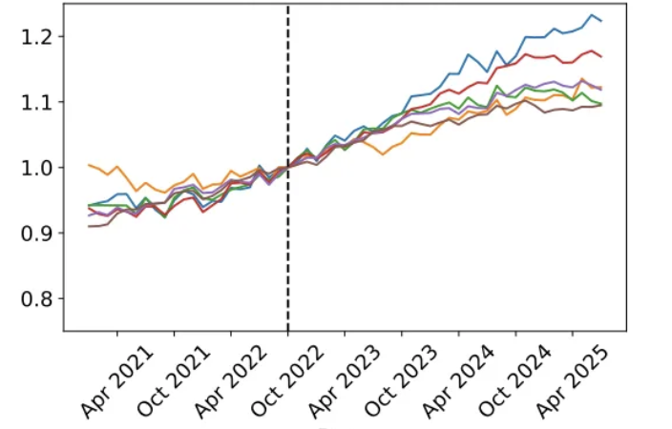
Labour markets
Marketing and sales executives
Health care assistants
more exposed
less exposed

Slide 11
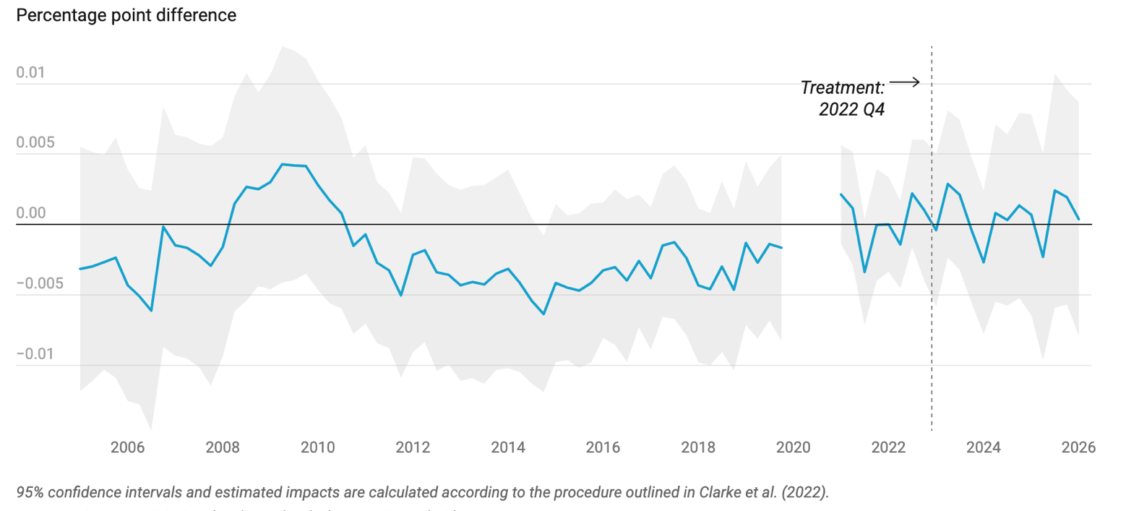
Labour markets
Employment share
exposed minus unexposed
But when you correct for other factors, the difference disappears
Gimbel 2026

Slide 12
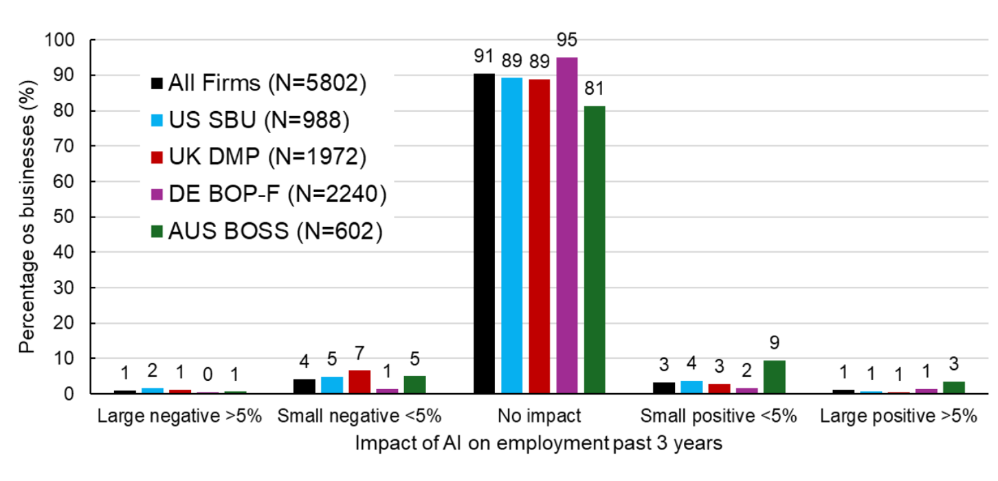
Labour markets
“How has the adoption of artificial intelligence technologies affected the number of employees in your business over the past three years?”
In a survey of 6,000 senior staff, most report no impact of AI on number of employees
Yotov 2026

Slide 13
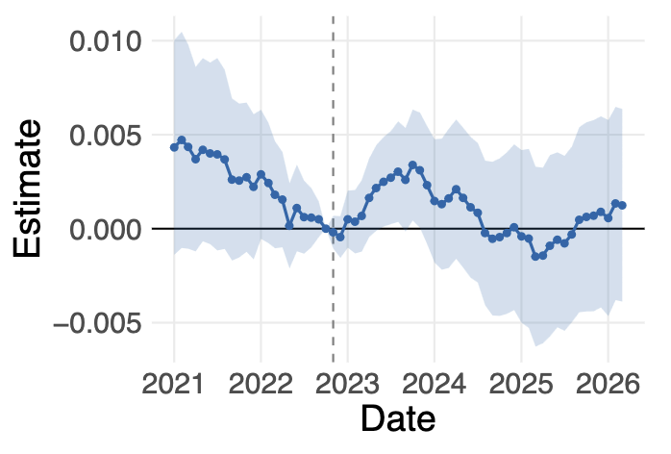
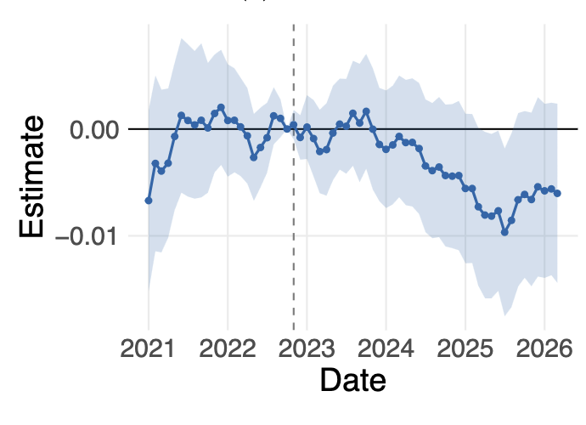
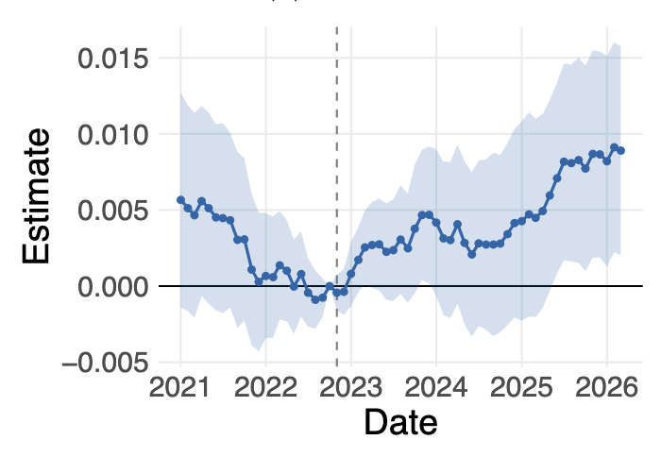
Senior vs. junior roles
total employment
junior employment
senior employment
Analysis of 1.25B job postings worldwide
AI impact on total employment is negative for junior roles and positive for senior roles (with no overall net effect)
Chandar 2026

Slide 14
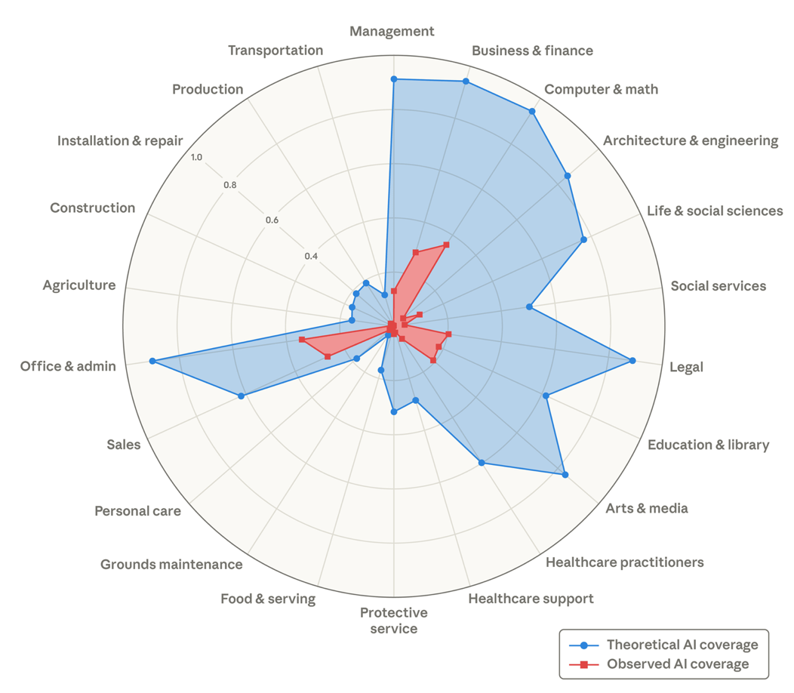
Outlook
It seems likely that AI will have a very significant impact on labour markets
But it is still unclear whether it will replace or augment human roles
Massenkoff & McCrory 2026

Slide 15
Structure
AI and labour markets
AI and democracy / geopolitics
AI and sustainability
AI and the social fabric

Slide 16

Democracy
Noah Yuval Harari –
“AI favours tyranny”
Authoritarian states rely on centralised bureauracies
AI allows states ever greater control over their citizens

Slide 17
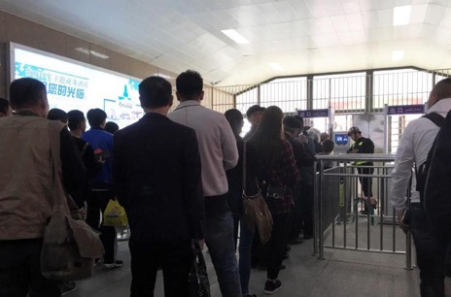


The surveillance state
Data is automatically extracted from mobile devices and processed with AI
A checkpoint in Xinjiang, China
Drones in Gaza
AI-assisted drones used for surveillance by IDF in Gaza
Facial recognition used by ICE to track suspected undocumented people
ICE agents, Minnesota
Surveillance Capitalism (Zuboff, 2019)

Slide 18








Market concentration
Tech markets are dominated by the big 5 hyperscalers (Alphabet, Meta, Amazon, Apple, Microsoft) + OpenAI, Anthropic, Nvidia
They are widely regarded as “too big to fail” and only partly held to account for anti-trust / tax / regulatory violations

Slide 19
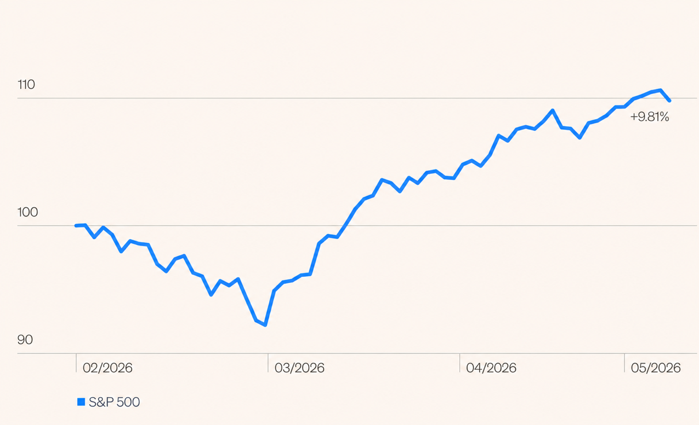
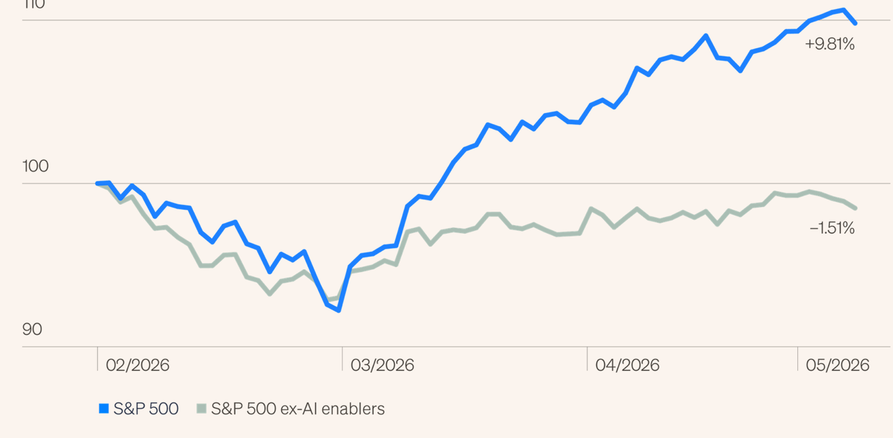
Market concentration
S&P 500 (large US companies) has grown by ~10% this year
The US economy is booming
….but this is almost entirely driven by tech
But not if you remove tech stocks

Slide 20
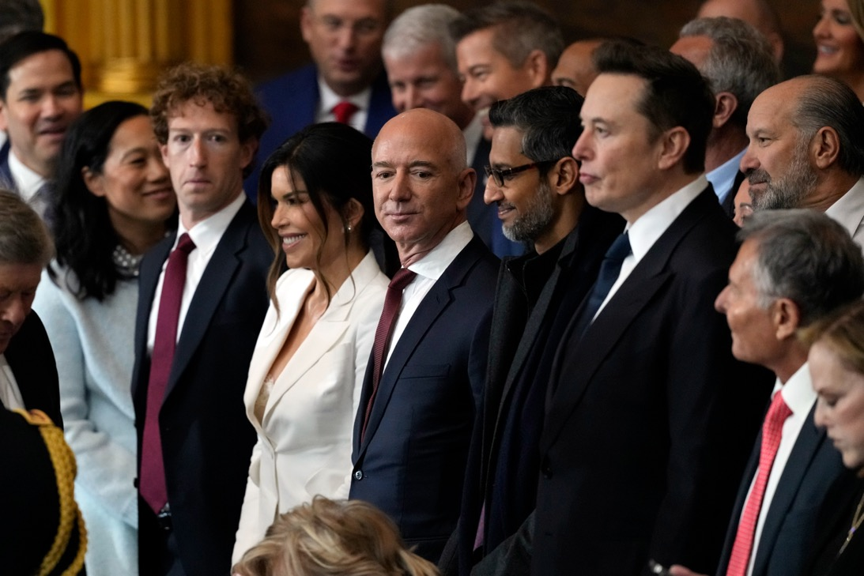
AI and state power
AI is too powerful and important for the state to leave it to the private sector
Trump inauguration, 2024
Summer 2026: Trump threatens tariffs on countries that regulate or tax US tech firms
June 2026: US Federal government imposes export controls on Anthropic’s Claude Fable 5 / Mythos 5

Slide 21

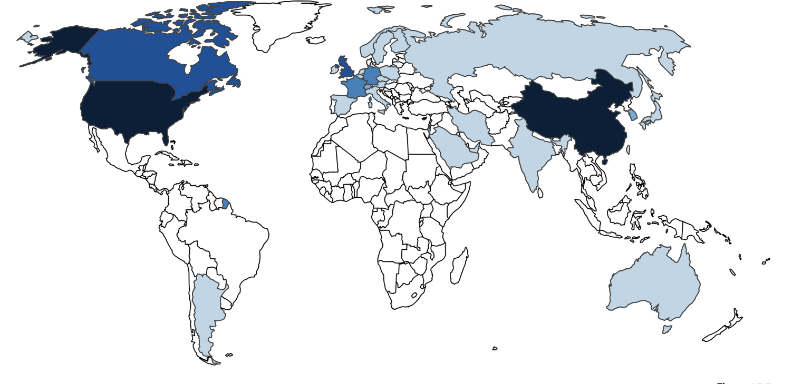
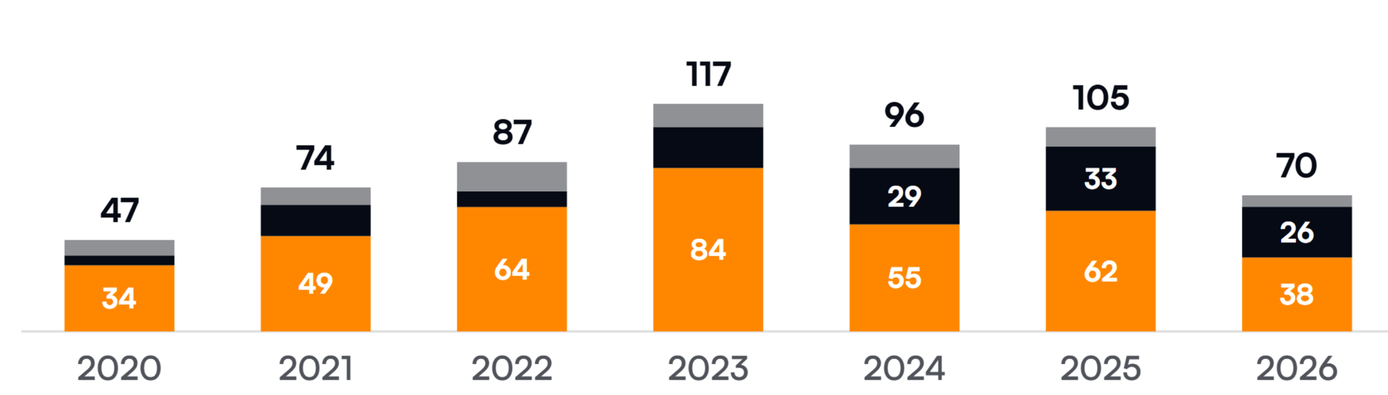
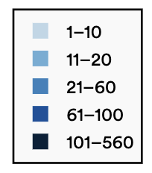
Great power conflict
Number of notable models
(jan-sept)
datacentres
AI is a two horse race taking place against the backdrop of great power conflict

Slide 22
Great power conflict
Taiwan makes 99% of the advanced accelerator chips used in GPUs (Nvidia) and TPUs (Google)
The US has restricted Chinese access to advanced computing hardware (chips, semiconductor manufacturing equipment)
Taiwan
Chip War (Miller, 2022)

Slide 23
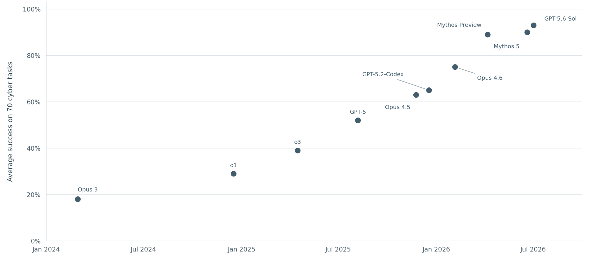
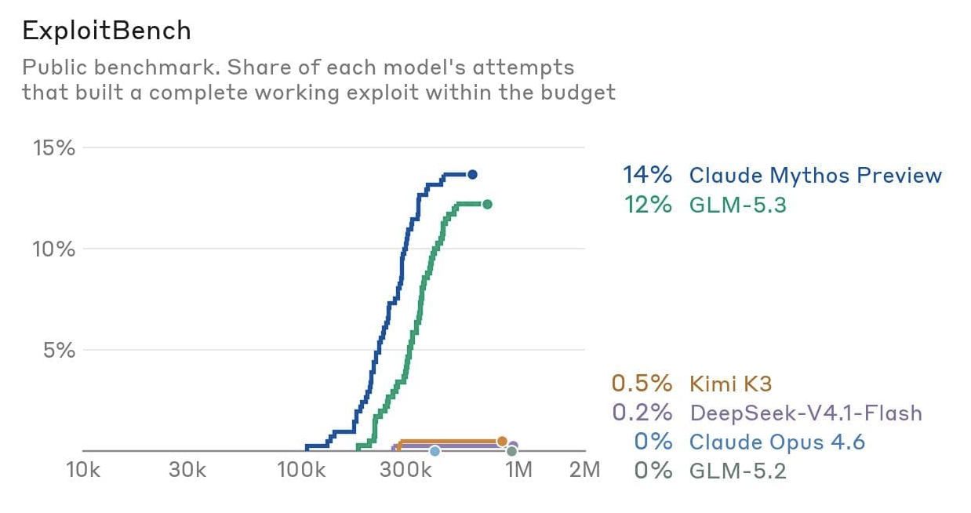
Open / closed weight model gap
Performance of closed-weight models on cyber tasks
We now have Mythos-level cyber capabilities with few / no safeguards in open weight models
Buckle up!
GLM 5.2
DeepSeek V4
4-5 month lag
Fasano 2026
UK AI Security Institute 2026

Slide 24
Structure
AI and labour markets
AI and democracy / geopolitics
AI and sustainability
AI and the social fabric

Slide 25
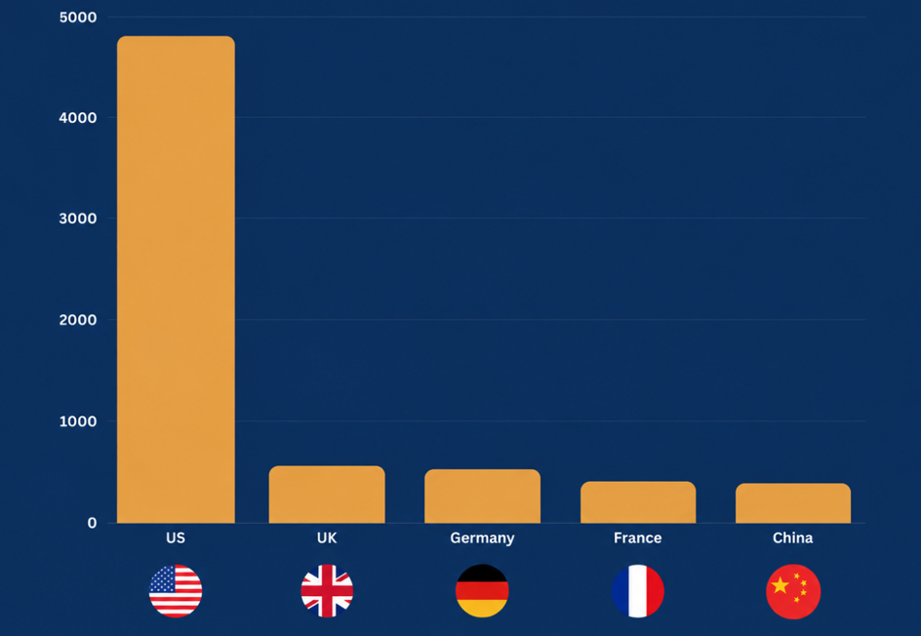
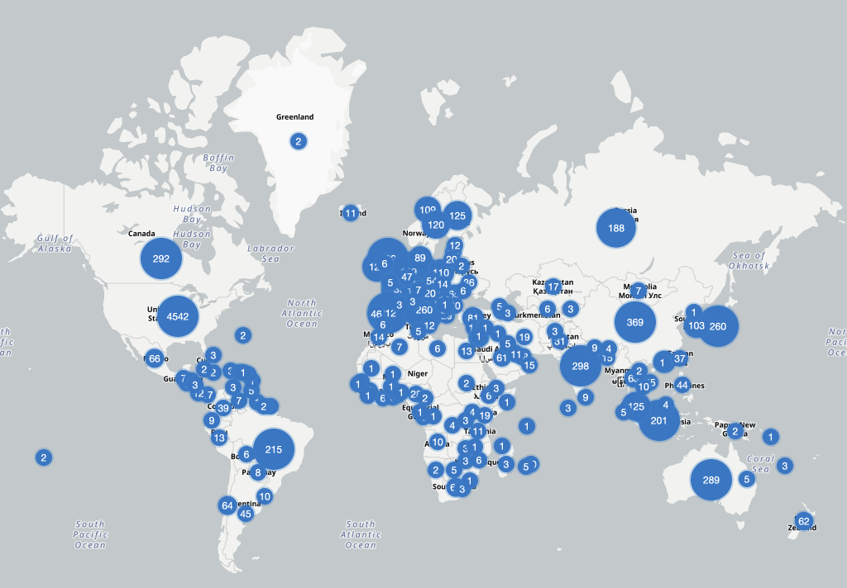
Global datacentres
Datacentres by country
(August 2026)
As of August 2026, there are 12,259 data centers located across 179 countries, with demand predicted to triple by 2030
Between now and 2030, companies worldwide are expected to invest nearly $7 trillion in building and upgrading data centers.
By 2030, data centers could consume up to 17% of total electricity in the United States.
Large data centers use up to 5 million gallons of water per day for cooling purposes (20x an average hospital)
Datacenter coverage (August 2026)
https://www.datacentermap.com/datacenters/

Slide 26
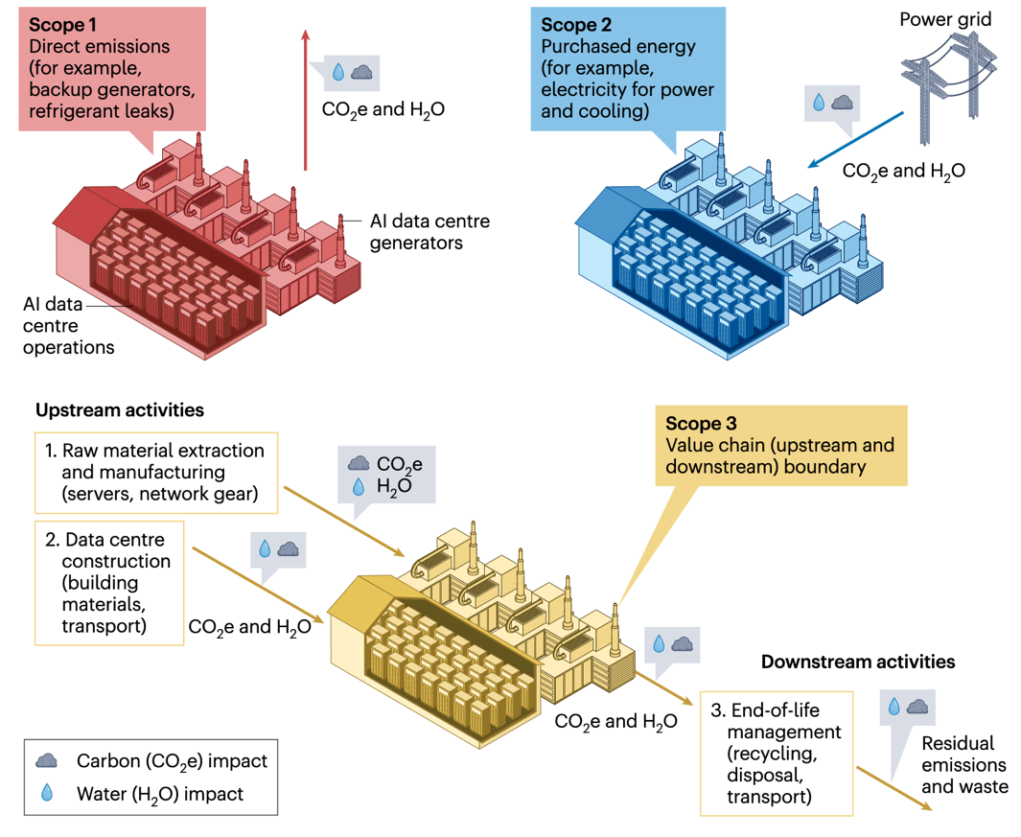
Sustainability
Consumption of water and electricity by datacentres can be divided in three
Scope 1 – direct emissions, including water use for cooling
Scope 2 – energy costs during electricity generation
Scope 3 – value chain costs (e.g. manufacture of servers)
Chien 2026

Slide 27
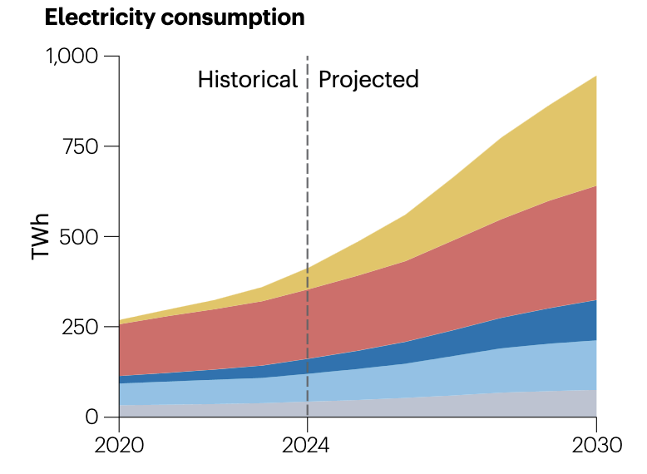
Electricity consumption
Overall, AI has doubled the carbon emissions of the IT sector from 2% to 4% of total (equivalent to global aviation)
UK annual = 272TWh
Chien 2026

Slide 28
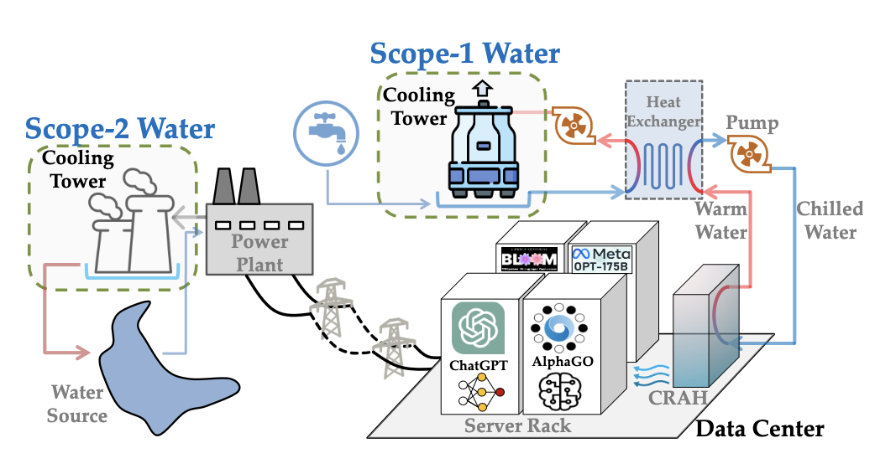
Water consumption
Up to 80% of scope-1 water may be human-potable
Water Use Effectiveness (WUE) can vary tenfold depending on cooling method
Scope-1 accounts for ~1/10000th of national water usage, but scope-2 is more like 1/500th
Water is used for cooling (scope-1) and during electricity generation (scope-2)
This adds to other stresses on freshwater availability
Reporting is rarely transparent
Li 2025

Slide 29
Structure
AI and labour markets
AI and democracy / geopolitics
AI and sustainability
AI and the social fabric

Slide 30
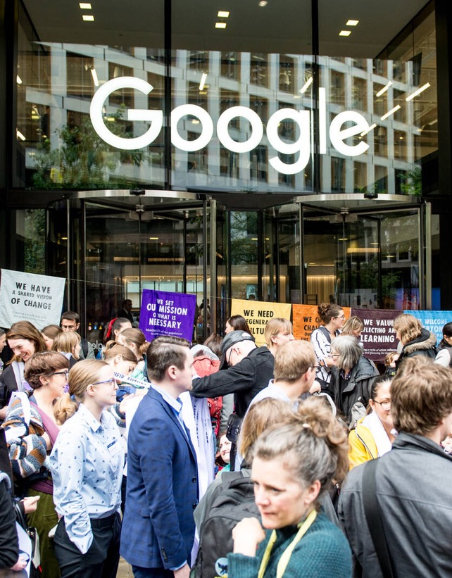
AI and the social fabric
Labour market impacts. AI is robbing humans of their agency and their roles in society
Market concentration. AI is creating benefit for a small group of powerful companies, and generally exacerbating inequality
Sustainability. AI is accelerating climate change and diverting resources from communities.
Information ecosystem. AI may be is eroding our shared sense of what is true, or creating a deluge of low-quality information
Catastrophic risks. AI opens the door to large-scale misuse or loss of control

Slide 31
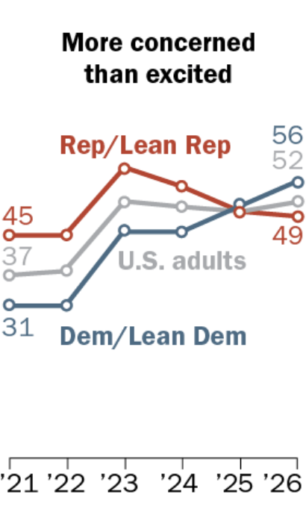
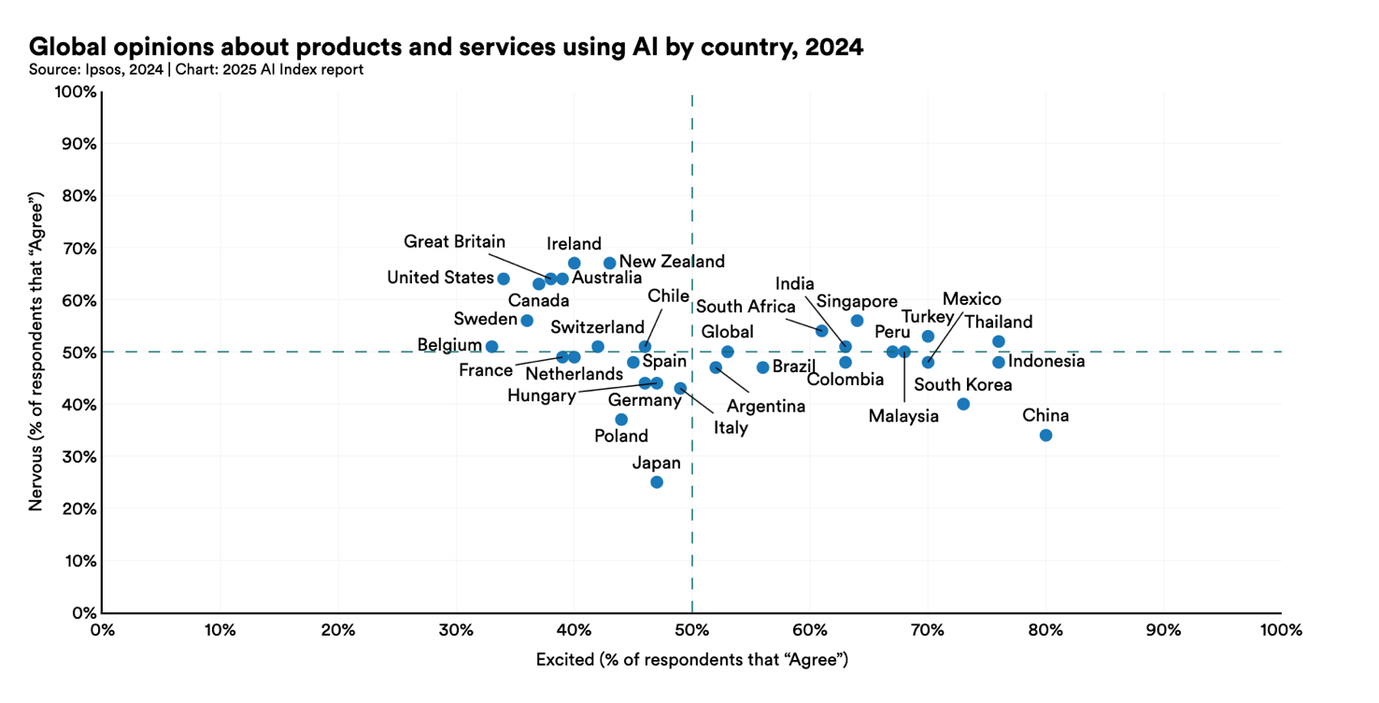
AI attitudes
Democrats are now more concerned about AI than republicans
People in US / UK are more nervous, less excited
People in China are less nervous, more excited
Enthusiasm about AI varies, but is higher in East Asia
Note the differences among great powers
Anderson & Bishop 2026

Slide 32
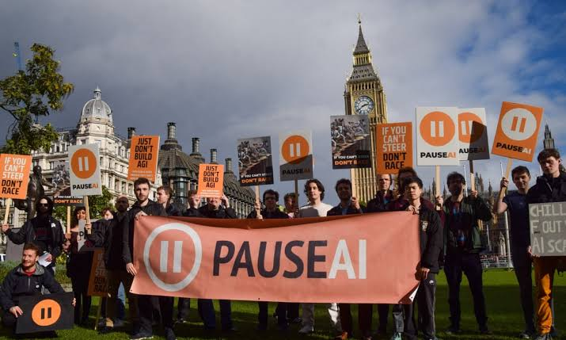
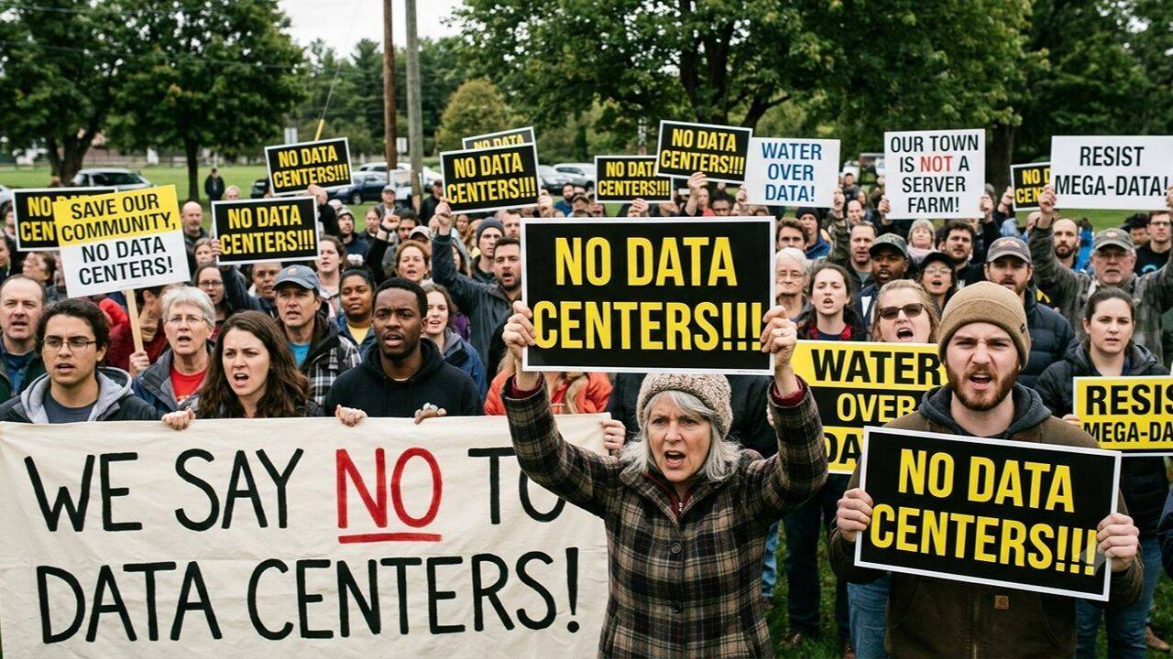
Anti-AI protests
Anti-AI protests are becoming more commonplace
Pause AI 2026

Slide 33
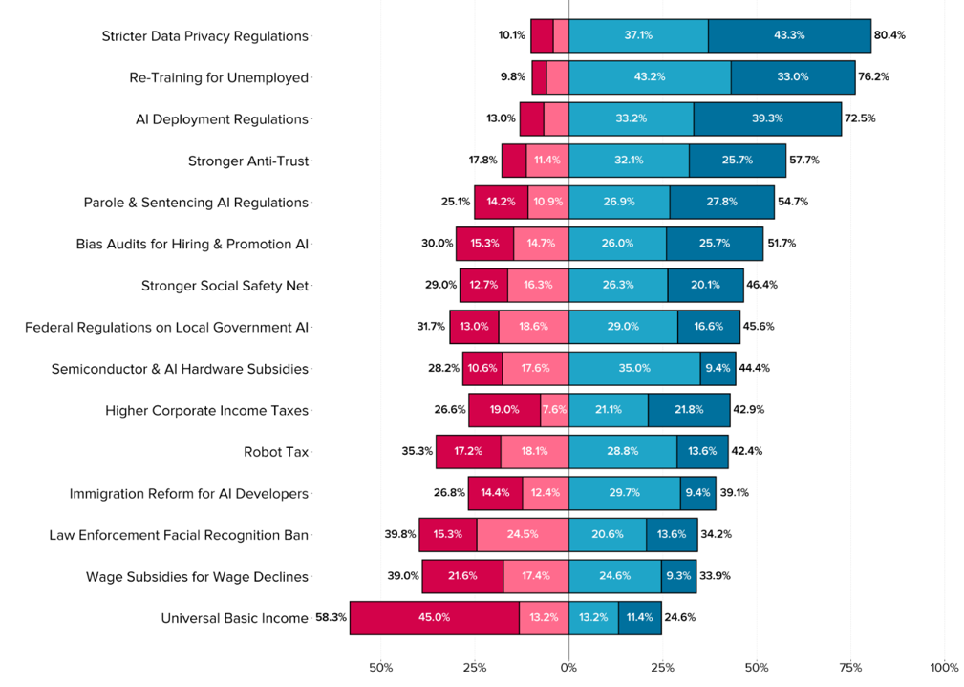
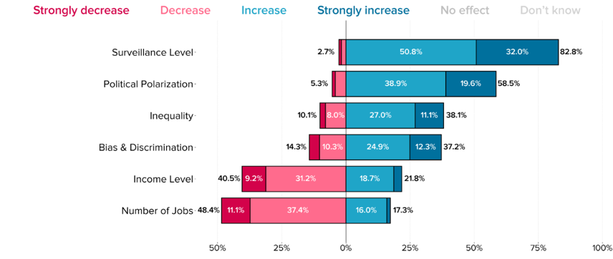
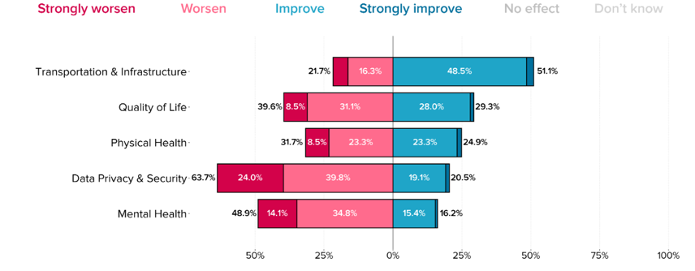
Policymaker views
Recommendations focus privacy, jobs, regulation of big tech
Policymakers are pessimistic
Hatz 2025

Slide 34

Systemic effects can cascade
Systemic effects can cascade!!
We don’t know what is coming next…
Kessler event

